Slide 1
NCBI Databases
Dr. Muhammad Tahir
Assistant Professor
COMSATS University Islamabad,
Attock Campus
NOTE: Most slides derived from NCBI’s field guide

Slide 2
NCBI
Contain biological database.
GENBANK:
It is the genetic sequence database
Provides 42 different resource
Provides a simple and easy to use web interface
http://www.ncbi.nlm.nih.gov/
NCBI: National Center for Biotechnology Information
NLM: National Library of Medicine
NIH: National Institutes of Health
Notes:
Currently, NCBI receives and processes about 20,000 direct submission sequences per month, in addition to the approximately 200,000 bulk submissions that are processed automatically.
Collaboration with EMBL and DDBJ

Slide 3
Tools for analysis
BLAST
Primer-BLAST
B-Link
ORF finder
Genome workbench
Notes:
All tools can be downloaded and used on your local workstations as standalone.

Slide 4
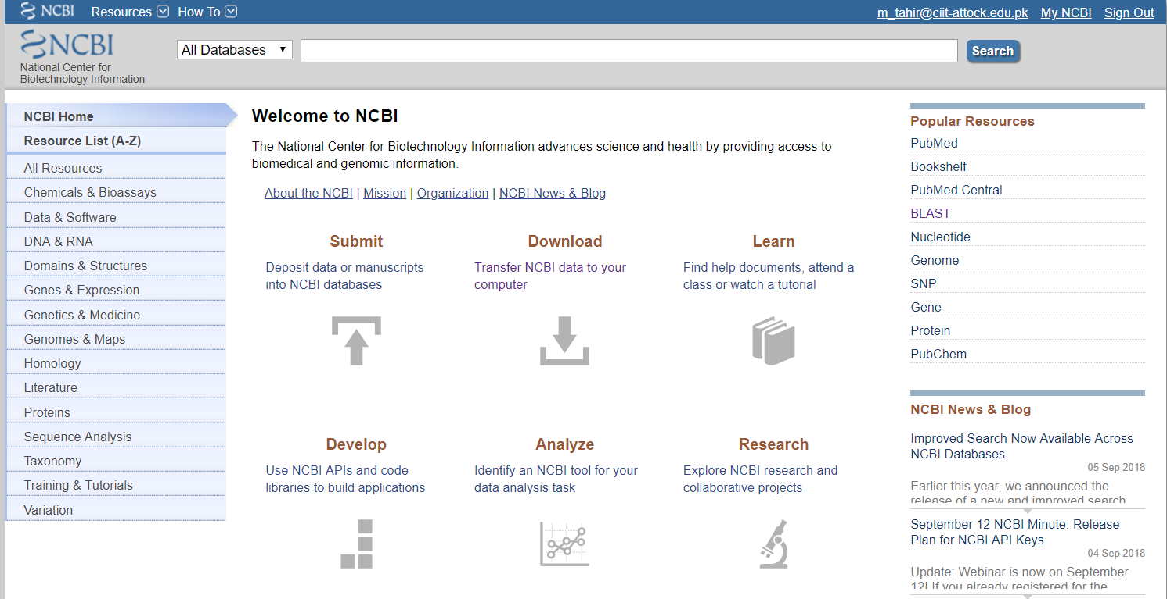
Web Access:
https://www.ncbi.nlm.nih.gov/
Notes:
NCBI homepage. Logo will take you back to home page.
About NCBI provides introduction to the NCBI and contains basic information on genetics and bioinformatics.

Slide 5
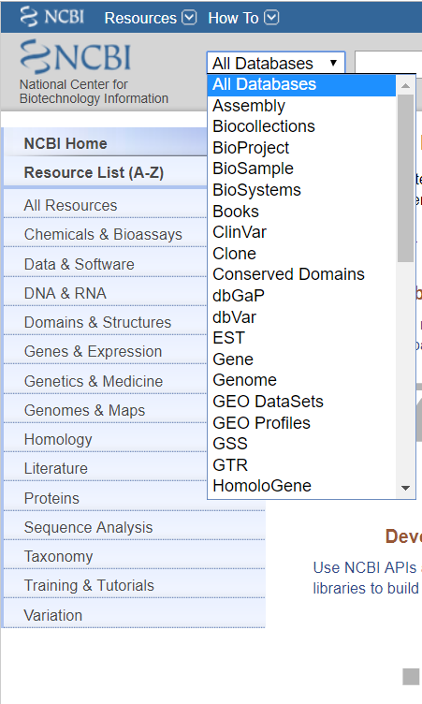
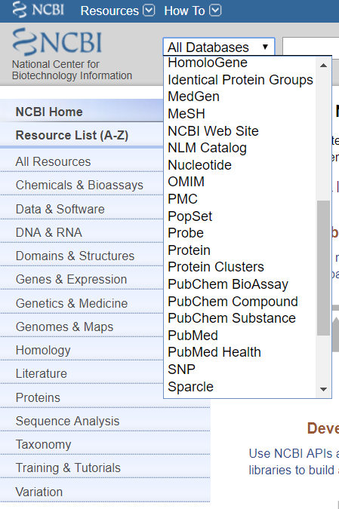
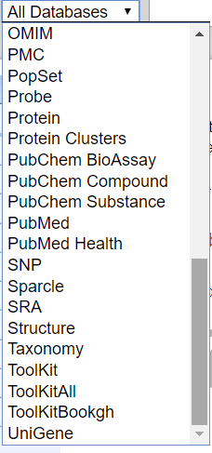

Slide 6
THE ‘PERFECT’ DATABASE
Comprehensive, but easy to search.
Well defined.
Easy to understand structure.
Cross-referenced.
Minimum redundancy.
Easy retrieval of data.

Slide 7
NCBI Databases and Services
GenBank primary sequence database
Free public access to biomedical literature
PubMed free Medline (3 million searches per day)
PubMed Central full text online access
Entrez integrated molecular databases

Slide 8
TYPES OF MOLECULAR DATABASES
Primary Databases
Primary databases contain data of molecules sequence.
Researchers are submitted data into the database.
Examples: GenBank, Trace, SRA, SNP, GEO
Derivative Databases
Derived from primary data
Content controlled by a third party (NCBI)
Examples: NCBI Protein, Refseq, TPA, RefSNP, GEO datasets, UniGene, Homologene, Structure, Conserved Domain
Notes:
Primary databases serve as a repository of experimentalist sequences (GenBank).
Derivative databases are sources of edited/curated sequences (RefSeq…reference sequences, UniGene...genes compared to genetic loci on genomes)

Slide 9
PRIMARY VS. DERIVATIVE SEQUENCE DATABASES
ACGTGC
RefSeq
C
C
GA
GA
Labs
ATT
GA
GA
C
ATT
C
TATAGCCG
AGCTCCGATA
CCGATGACAA
TATAGCCG
Sequencing
Centers
ACGTGC
Genome
Assembly
ATTGACTA
CGTGA
Curators
TTGACA
Updated
continually
by NCBI
TTGACA
TTGACA
ACGTGC
CGTGA
ACGTGC
TATAGCCG
CGTGA
ATTGACTA
TATAGCCG
TATAGCCG
ATTGACTA
ATTGACTA
CGTGA
ATTGACTA
ATTGACTA
ATT
TATAGCCG
TATAGCCG
TATAGCCG
TATAGCCG
TATAGCCG
TTGACA
C
GenBank
GA
UniGene
Updated ONLY
by submitters
AT
C
C
C
C
ATT
GA
GA
GA
GA
ATT
ATT
ATT
GA
GA
GA
GA
ATT
C
C
C
ATT
C
Algorithms
Notes:
~11,000 sequences are submitted per day.

Slide 10
Standard contents of a sequence database
Sequences
Accession number
References
Taxonomic data
Annotation/curation
Keywords
Cross-references
Documentation

Slide 11
Sequence Databases at NCBI
Primary
GenBank: NCBI’s primary sequence database
Trace Archive: reads from capillary sequencers
Sequence Read Archive: next generation data
Derivative
GenPept (GenBank translations)
Outside Protein (UniProt—Swiss-Prot, PDB)
NCBI Reference Sequences (RefSeq)

Slide 12
GENBANK - PRIMARY SEQUENCE DB
Nucleotide only sequence database
Archival in nature
Historical
Reflective of submitter point of view (subjective)
Redundant
Data
Direct submissions (traditional records)
Batch submissions
FTP accounts (genome data)

Slide 13
GENBANK - PRIMARY SEQUENCE DB (2)
Three collaborating databases
GenBank
DNA Database of Japan (DDBJ)
European Molecular Biology Laboratory (EMBL) Database

Slide 14
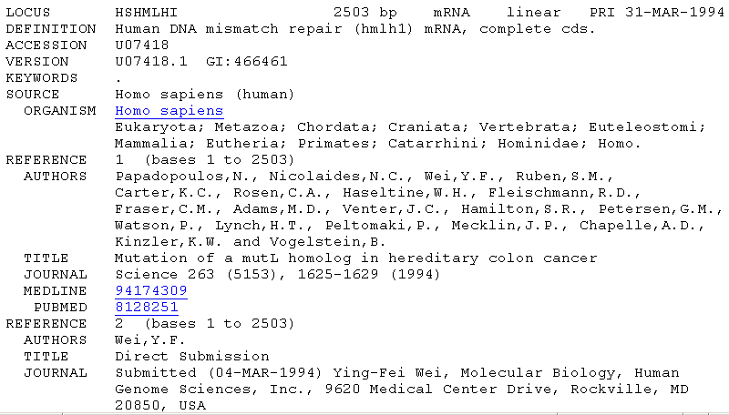
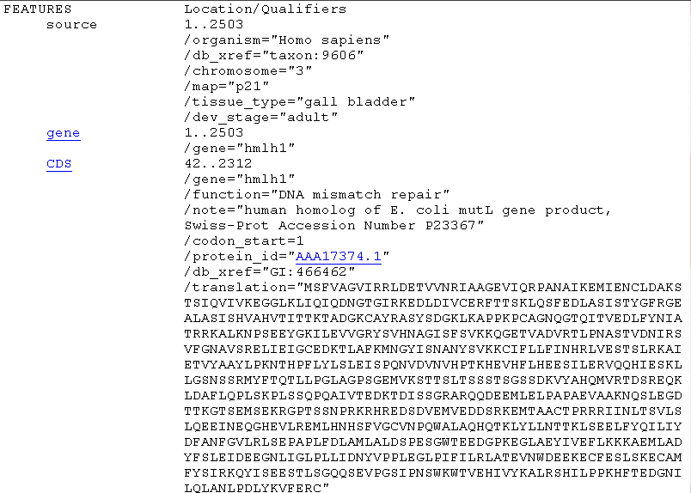
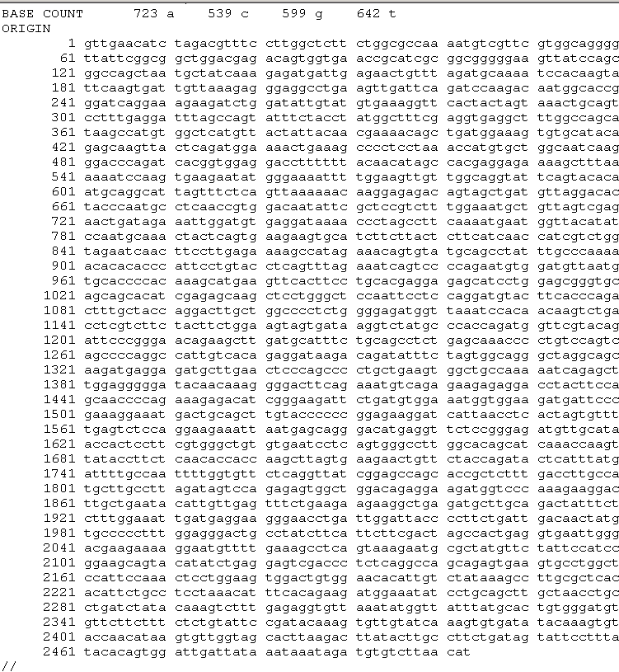
Traditional GenBank Record
Accession
Stable
Reportable
Universal
ACCESSION U07418
VERSION U07418.1 GI:466461
Version
Tracks changes in sequence
GI number
NCBI internal use
well annotated
the sequence is the data

Slide 15
Derivative Sequence Databases

Slide 16
GenPept is a database of GenBank
FEATURES Location/Qualifiers
source 1..2484
/organism="Homo sapiens"
/mol_type="mRNA"
/db_xref="taxon:9606"
/chromosome="3"
/map="3p22-p23"
gene 1..2484
/gene="MLH1"
CDS 22..2292
/gene="MLH1"
/note="homolog of S. cerevisiae PMS1 (Swiss-Prot Accession
Number P14242), S. cerevisiae MLH1 (GenBank Accession
Number U07187), E. coli MUTL (Swiss-Prot Accession Number
P23367), Salmonella typhimurium MUTL (Swiss-Prot Accession
Number P14161) and Streptococcus pneumoniae (Swiss-Prot
Accession Number P14160)"
/codon_start=1
/product="DNA mismatch repair protein homolog"
/protein_id="AAC50285.1"
/db_xref="GI:463989"
/translation="MSFVAGVIRRLDETVVNRIAAGEVIQRPANAIKEMIENCLDAKS
TSIQVIVKEGGLKLIQIQDNGTGIRKEDLDIVCERFTTSKLQSFEDLASISTYGFRGE
ALASISHVAHVTITTKTADGKCAYRASYSDGKLKAPPKPCAGNQGTQITVEDLFYNIA
TRRKALKNPSEEYGKILEVVGRYSVHNAGISFSVKKQGETVADVRTLPNASTVDNIRS
>gi|463989|gb|AAC50285.1| DNA mismatch repair prote...
MSFVAGVIRRLDETVVNRIAAGEVIQRPANAIKEMIENCLDAKSTSIQVIV...
EDLDIVCERFTTSKLQSFEDLASISTYGFRGEALASISHVAHVTITTKTAD...

Slide 17
REFSEQ: DERIVATIVE SEQUENCE DATABASE
Curated transcripts and proteins
Model transcripts and proteins
Assembled Genomic Regions
Chromosome records
Human genome
microbial
organelle
ftp://ftp.ncbi.nih.gov/refseq/release/
Notes:
Goal= nonredundant set of genes/proteins for each organism represented
Model= comes from analysis of genomic content from organism assembly
Reannotation of microbial genomes, for example.

Slide 18
Sequence submission: done using Bankit or Sequin
Search Engine for data retrieval: Entrez
Retrieves information across all the resources under NCBI
Example: PubMed, taxonomy, SNP, PubChem etc.
Notes:
Database continues to grow at exponential rate.
Doubling in size every 10 months
Has sequences of 250,000 distinct organisms

Slide 19
Selected RefSeq Accession Numbers
mRNAs and Proteins
NM_123456 Curated mRNA
NP_123456 Curated Protein
NR_123456 Curated non-coding RNA
XM_123456 Predicted mRNA
XP_123456 Predicted Protein
XR_123456 Predicted non-coding RNA
Gene Records
NG_123456 Reference Genomic Sequence
Chromosome
NC_123455 Microbial replicons, organelle
genomes, human chromosomes
AC_123455 Alternate assemblies
Assemblies
NT_123456 Contig
NW_123456 WGS Supercontig
Notes:
Two letter prefix, underscore, numeric portion.
NT=contig assemblies produced by NCBI
NW=supercontig assembles from WGS

Slide 20
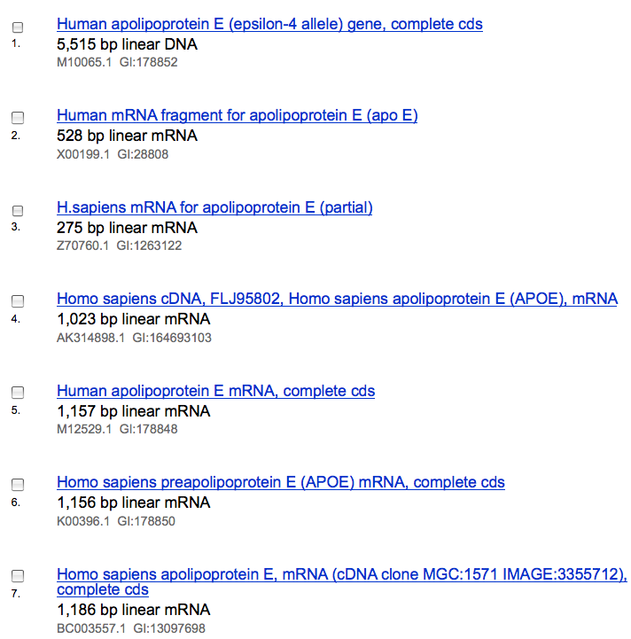

GenBank to RefSeq

Slide 21

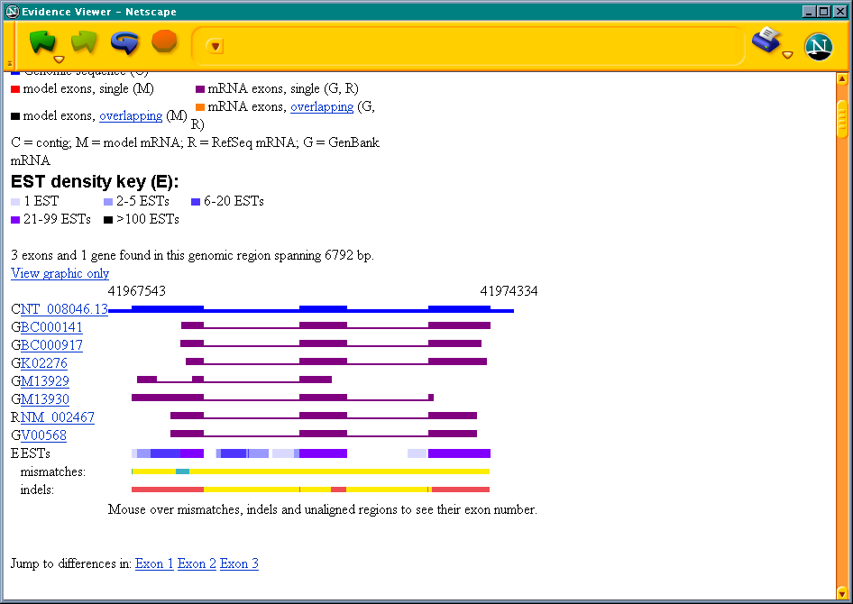
RefSeqs: Annotation Reagents
Genomic DNA
(NC, NT, NW)
Scanning....
Model mRNA (XM)
(XR)
Model protein (XP)
= ?
Curated mRNA (NM)
(NR)
Curated Protein (NP)
RefSeq
GenBank
Sequences

Slide 22
RefSeq Benefits
Non-redundancy
Updates to reflect current sequence data and biology
Data validation
Format consistency
Distinct accession series
Stewardship by NCBI staff and collaborators

Slide 23
Other Derivative Databases
Expressed Sequences
dbSNP
Structure
Gene
and more…

